Slide 1

EVENT EASE
MARWADI UNIVERSITY
FACULTY OF DIPLOMA STUDIES
COMPUTER ENGINEERING DEPARTMENT
Prepared by:
Mahir Kadivar : 92300938023
Mohib Khorajiya : 92300938024
Sarth Vaghela : 92300938025
Sunera Sherasiya : 92300938028
SEMESTER : 6
Project Review - 4
Guided by:
Prof. Kruti Rathod

Slide 2
CONTENT
Abstract
Aim / Objectives
Specific Requirements(Software/Hardware)
System Design(Diagrams)
Reference and Sources
Summary

Slide 3
Abstract
Event Ease is a smart, web-based platform designed to simplify the entire process of event booking and management. It allows users to easily register, explore events by category, date, or popularity, and book events along with optional add-on services like food packages or pickup/car service. The system automatically calculates total charges and generates a digital ticket with a dynamic QR code for secure entry. Users also receive email notifications and can download tickets directly from their dashboard.

Slide 4
On the admin side, a secure role-based panel allows authorized staff to manage events, approve or cancel bookings, handle feedback, and update the event gallery. Users can view their booking history, payment status, and share feedback and ratings to help others. Built with HTML, CSS, JavaScript, Bootstrap, PHP, and MySQL, Event Ease offers an end-to-end digital solution for smooth, secure, and efficient event planning and management.

Slide 5
Objectives
The main objective of Event Ease is to provide a digital and user-friendly platform for smooth event booking and management. It aims to simplify the process for users by offering secure login, event browsing, and booking with optional services like food and transport.
Another goal is to help administrators manage events efficiently through a secure panel. The system also focuses on automating price calculation, ticket generation with QR codes, and offering real-time notifications to ensure a seamless experience for both users and admins.

Slide 6
Aim
The aim of the project is to develop a smart, secure, and user-friendly web-based platform that simplifies the complete process of event booking and management for both users and administrators, by providing digital solutions for registration, event browsing, booking with add-on services, automated payments, ticket generation, and system management.

Slide 7
Specific Requirements(Software/Hardware)
Software Requirements:
Operating System: Windows 10 or higher / Linux / macOS
Web Browser: Chrome / Firefox / Edge (latest versions)
Web Technologies:
- HTML, CSS, JavaScript, Bootstrap
- PHP (Server-side scripting)
- MySQL (Database)
XAMPP / WAMP Server (for local development)
Code Editor: Visual Studio Code / Sublime Text
Email API (for sending ticket confirmations)

Slide 8
Hardware Requirements:
Processor: Intel i3 or above
RAM: Minimum 4 GB (8 GB recommended)
Storage: Minimum 250 MB for project files
Internet Connection (for online access & email notifications)
QR Code Scanner (optional, for event entry validation)

Slide 9
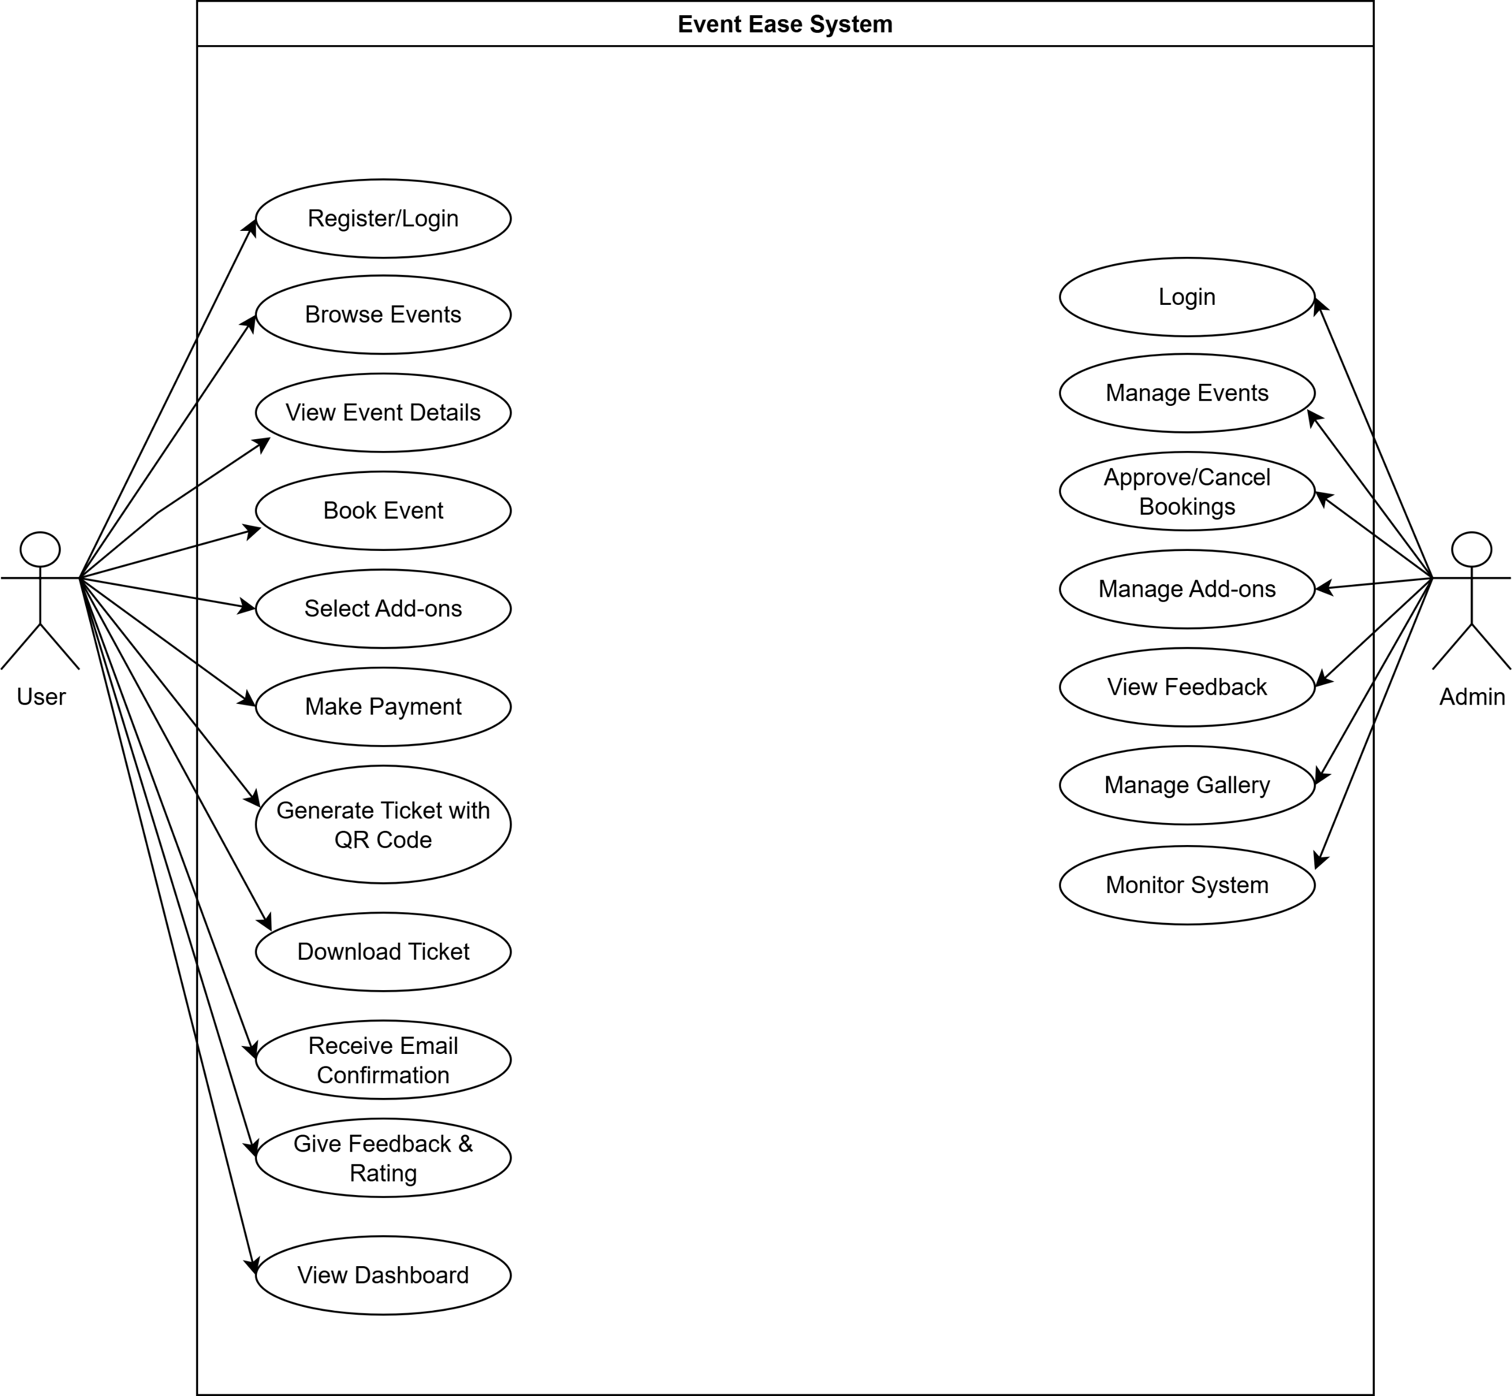
System Design(Diagrams)
Usecase Diagram:

Slide 10
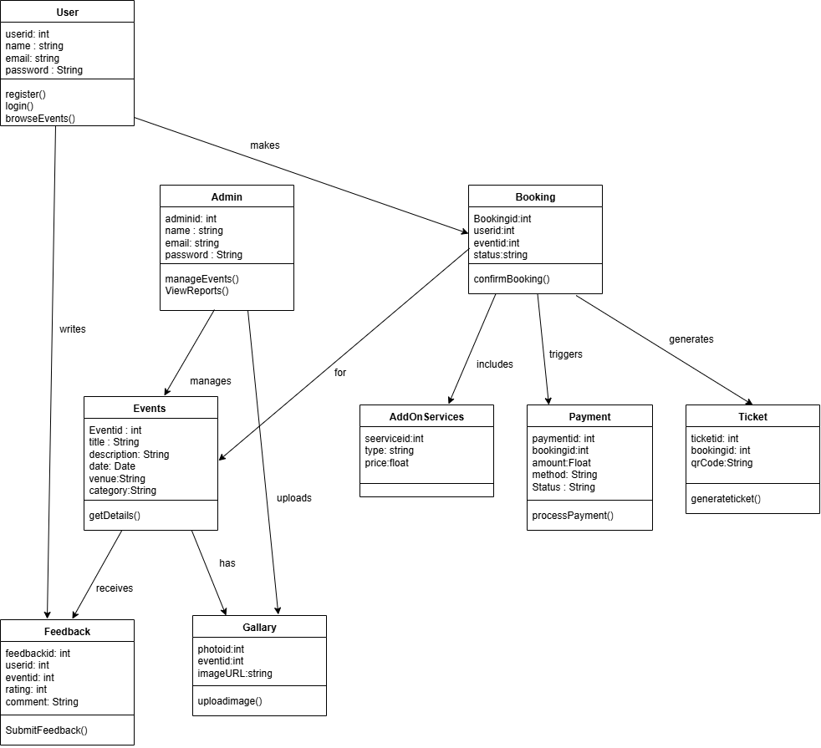
Class Diagram:

Slide 11
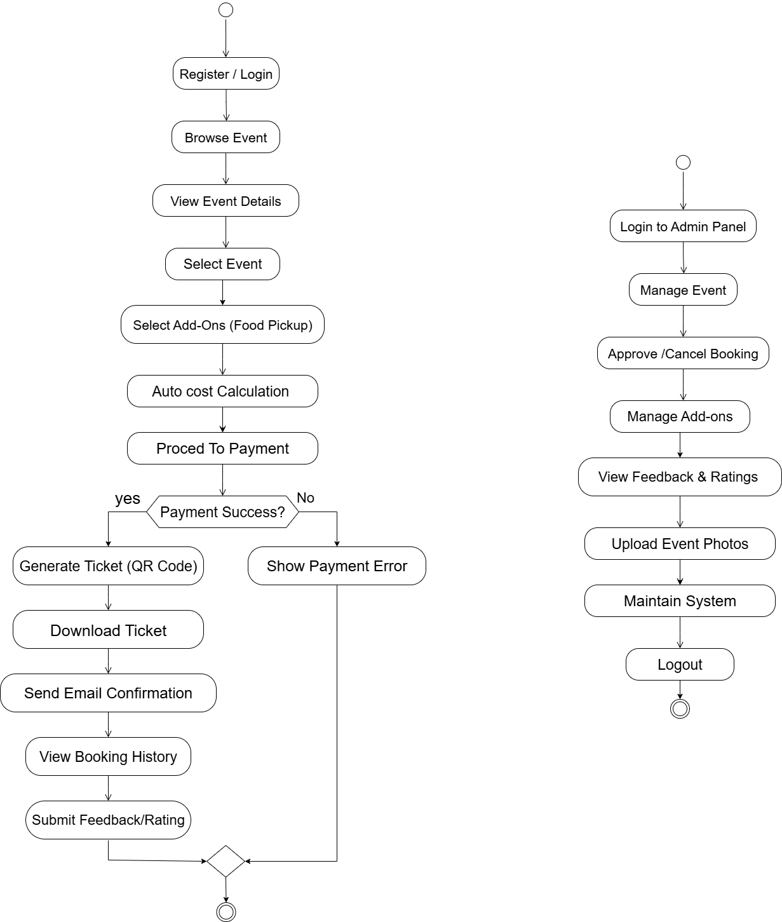
Activity Diagram:

Slide 12
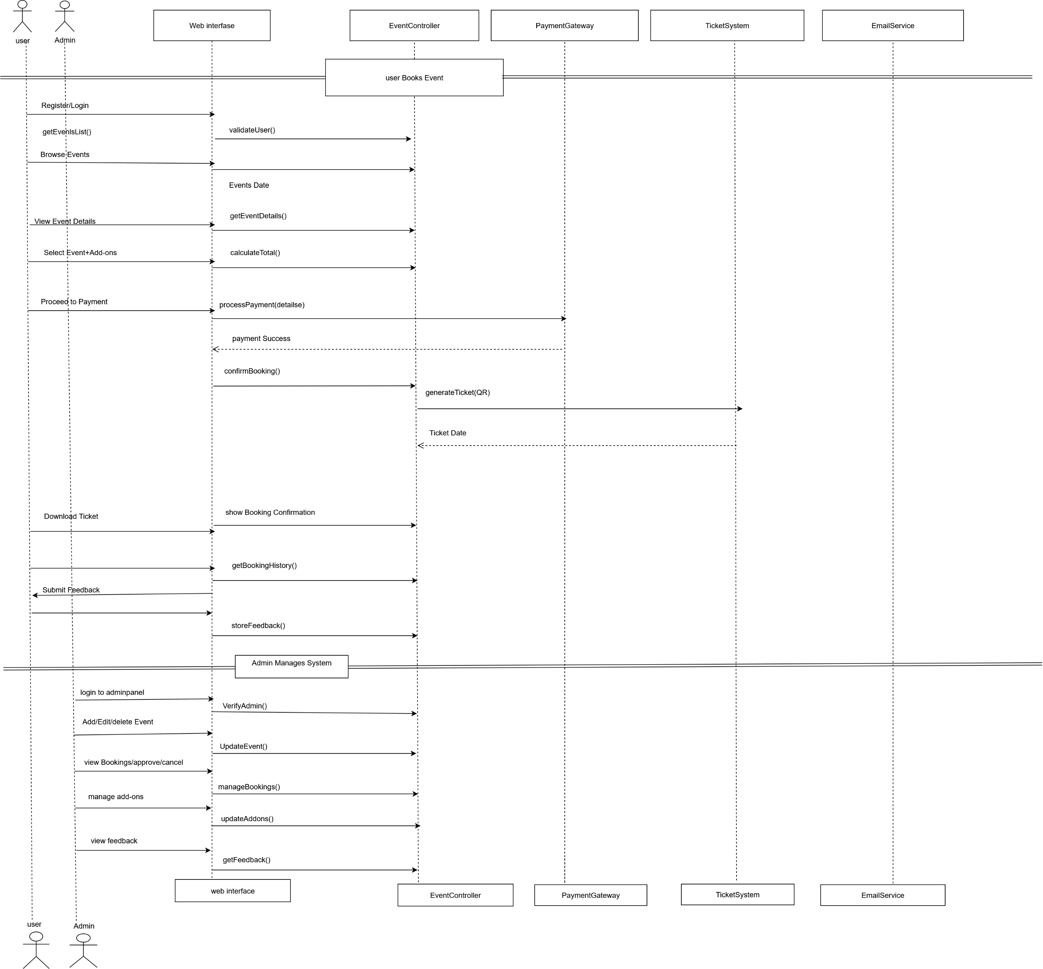
Sequence Diagram:

Slide 13
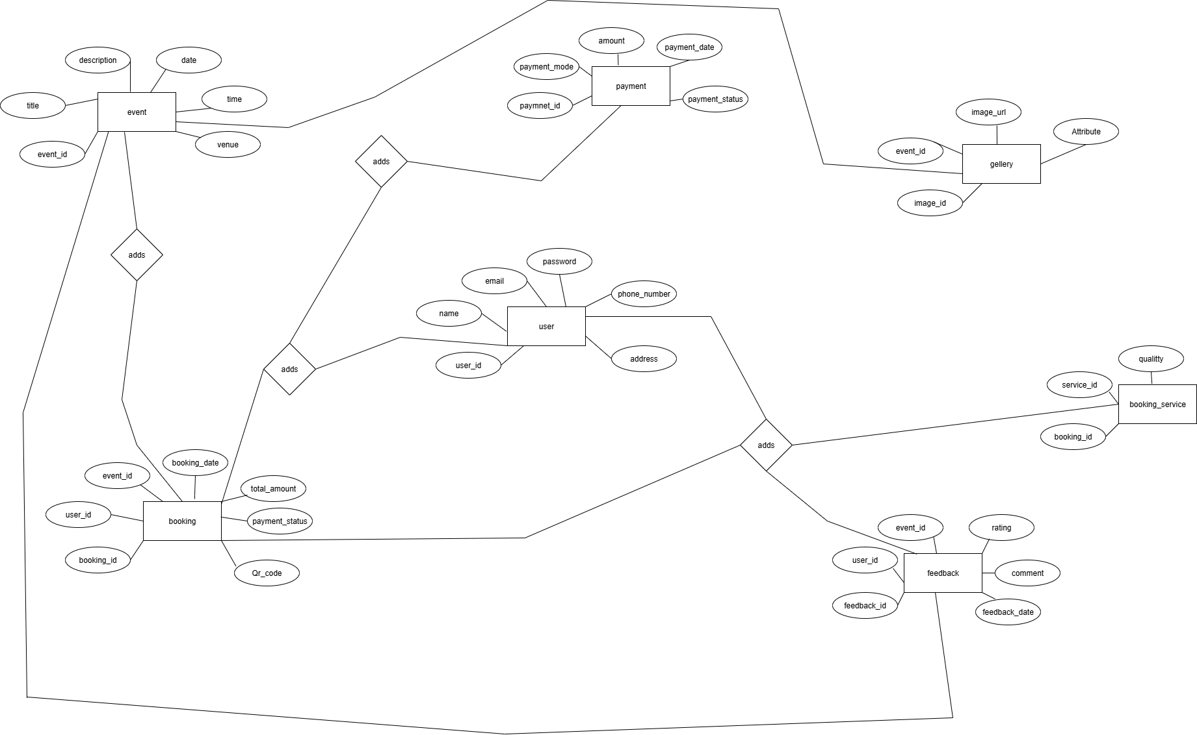
ER Diagram:

Slide 14
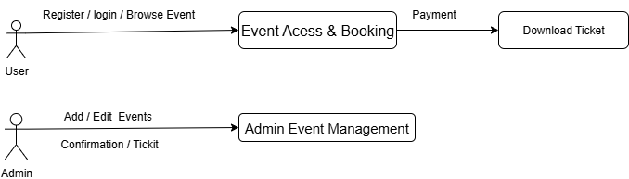
DFD Level-0 Diagram:

Slide 15
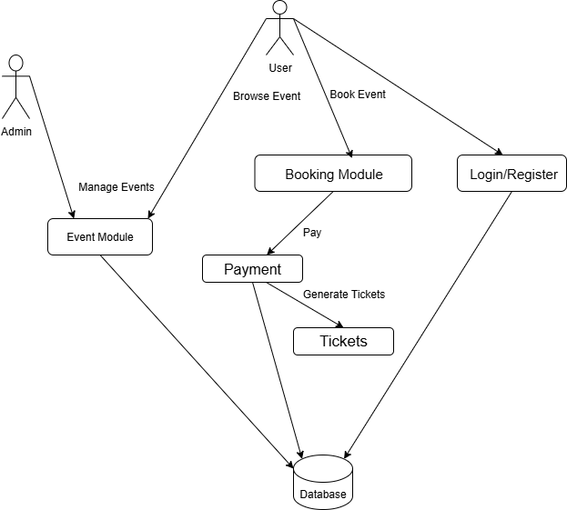
DFD Level-1 Diagram:

Slide 16
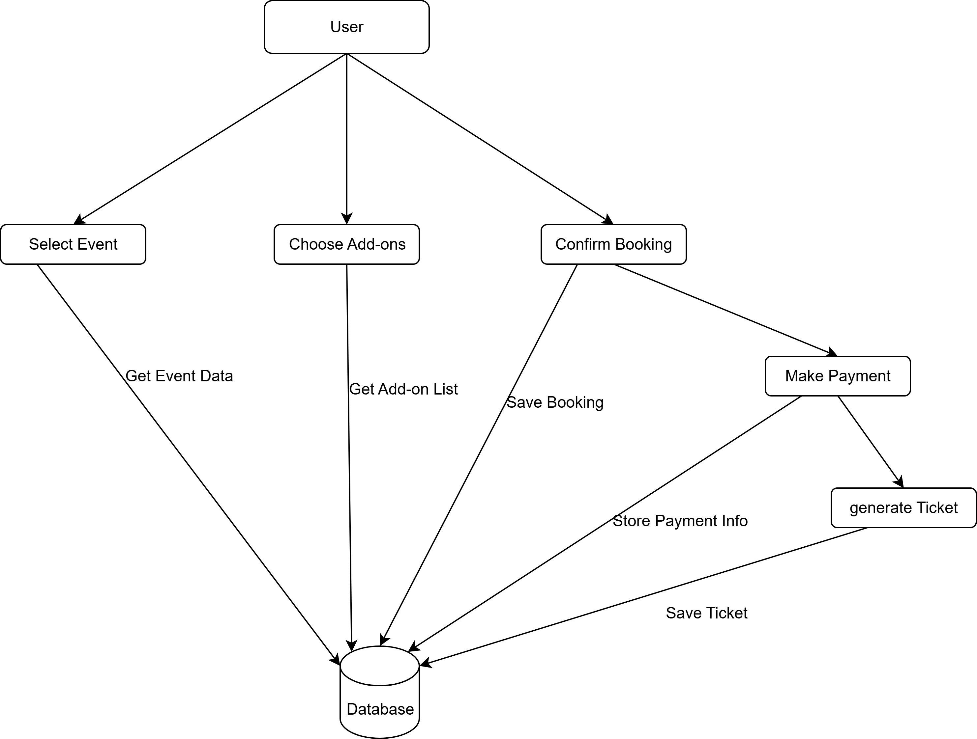
DFD Level-2 Diagram:

Slide 17
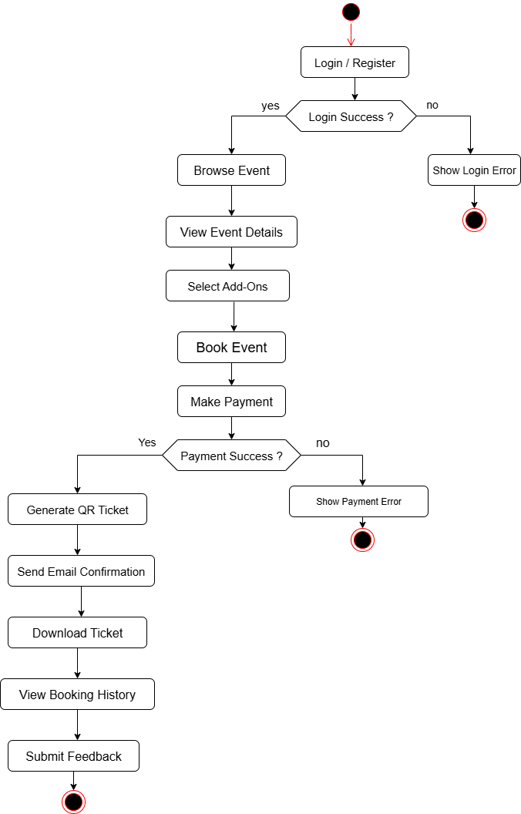
FlowChart:

Slide 18
Reference and Sources
Official PHP Documentation – https://www.php.net/docs.php
MySQL Reference Manual – https://dev.mysql.com/doc/
W3Schools Web Tutorials – https://www.w3schools.com
Bootstrap Documentation – https://getbootstrap.com/docs
Stack Overflow – https://stackoverflow.com
Draw.io – https://app.diagrams.net (for UML diagrams)
Acknowledgments: We extend our sincere gratitude to our internal guide, Prof. [Kruti Raathod], for their invaluable guidance and support throughout this project. We also thank Marwadi University for providing the necessary resources and an encouraging environment. Finally, we appreciate the unwavering support from our families and peers.

Slide 19
Summary
Event Ease is a smart and user-friendly web-based platform designed to digitize and simplify the event booking and management process. It allows users to explore and book events with optional services like food and transport, while the system handles automatic price calculation and ticket generation with QR codes.
The platform offers a personal dashboard for users and a secure admin panel for event organizers. Built using HTML, CSS, JavaScript, Bootstrap, PHP, and MySQL, it provides a complete digital solution for smooth, secure, and efficient event planning and management — benefiting both users and administrators.

Slide 20
THANKYOU

